Slide 1
indigo: equilibrium and coilset design
M. Coleman, S. McIntosh

Slide 2
indigo: equilibrium and coilset designer
Written from scratch thanks to some great sources of inspiration and ideas:
Nova (S. McIntosh, CCFE => IO)
Constrained coil optimisation procedures
Optimisation architecture
FreeGS (B. Dudson, University of York)
Software architecture
Boundary algorithm and profile ideas
FIESTA (G. Cunningham, CCFE)
Tips on how to design equilibria from scratch
Very helpful sounding board!
Papers by R. Albanese, Y. M. Jeon, and F. Franza:
Albanese et al., 2018
Jeon, 2015
Franza et al., 2018

Slide 3
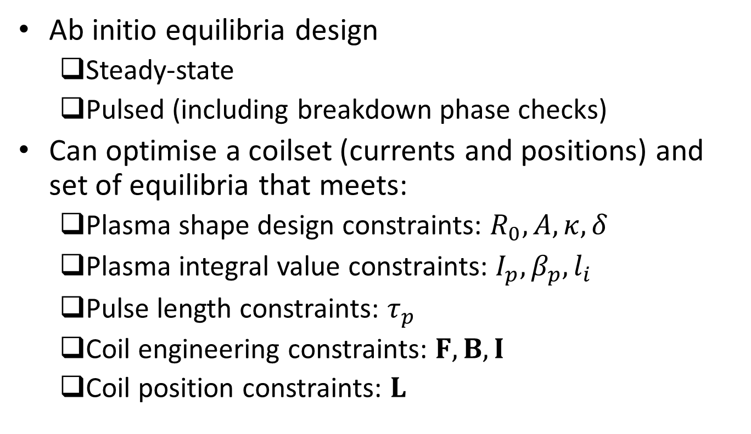
indigo: capabilities
Ab initio equilibria design
Steady-state
Pulsed (including breakdown phase checks)
Can optimise a coilset (currents and positions) and set of equilibria that meets:
Plasma shape design constraints: $R_{0}, A, κ, δ$
Plasma integral value constraints: $I_{p},β_{p}, l_{i}$
Pulse length constraints: $τ_{p}$
Coil engineering constraints: $F, B, I$
Coil position constraints: $L$

Slide 4
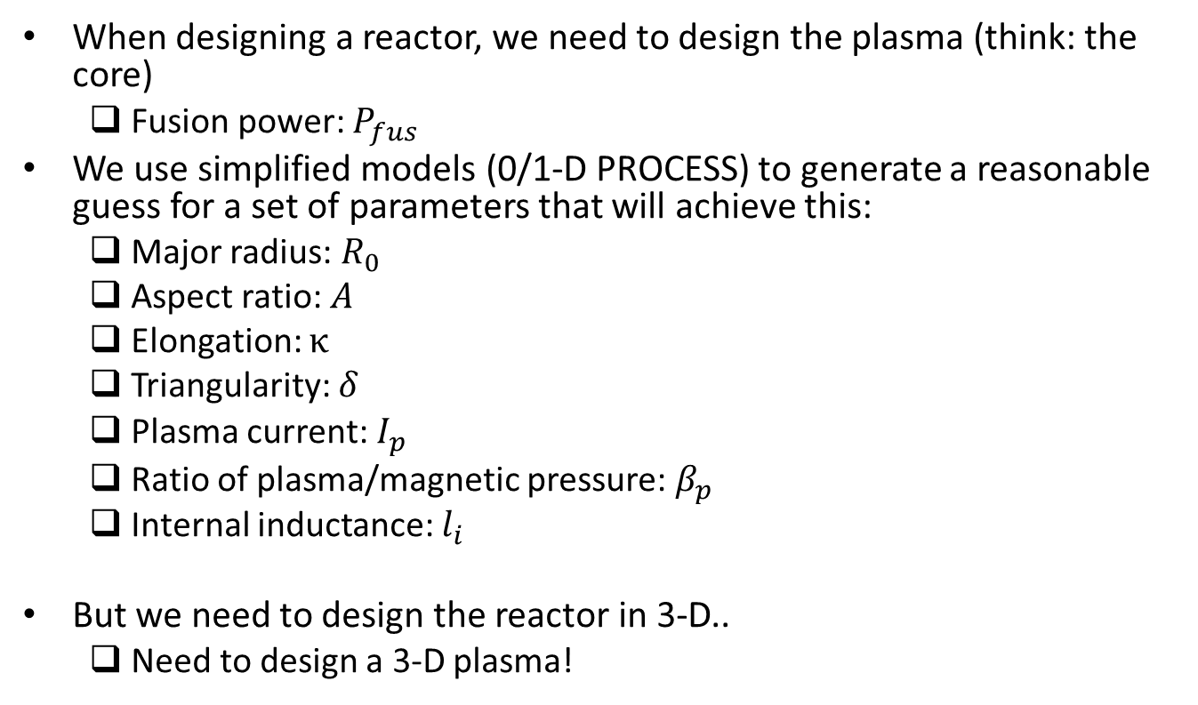
Problem definition - i
When designing a reactor, we need to design the plasma (think: the core)
Fusion power: $P_{fus}$
We use simplified models (0/1-D PROCESS) to generate a reasonable guess for a set of parameters that will achieve this:
Major radius: $R_{0}$
Aspect ratio: $A$
Elongation: $κ$
Triangularity: $δ$
Plasma current: $I_{p}$
Ratio of plasma/magnetic pressure: $β_{p}$
Internal inductance: $l_{i}$
But we need to design the reactor in 3-D..
Need to design a 3-D plasma!

Slide 5
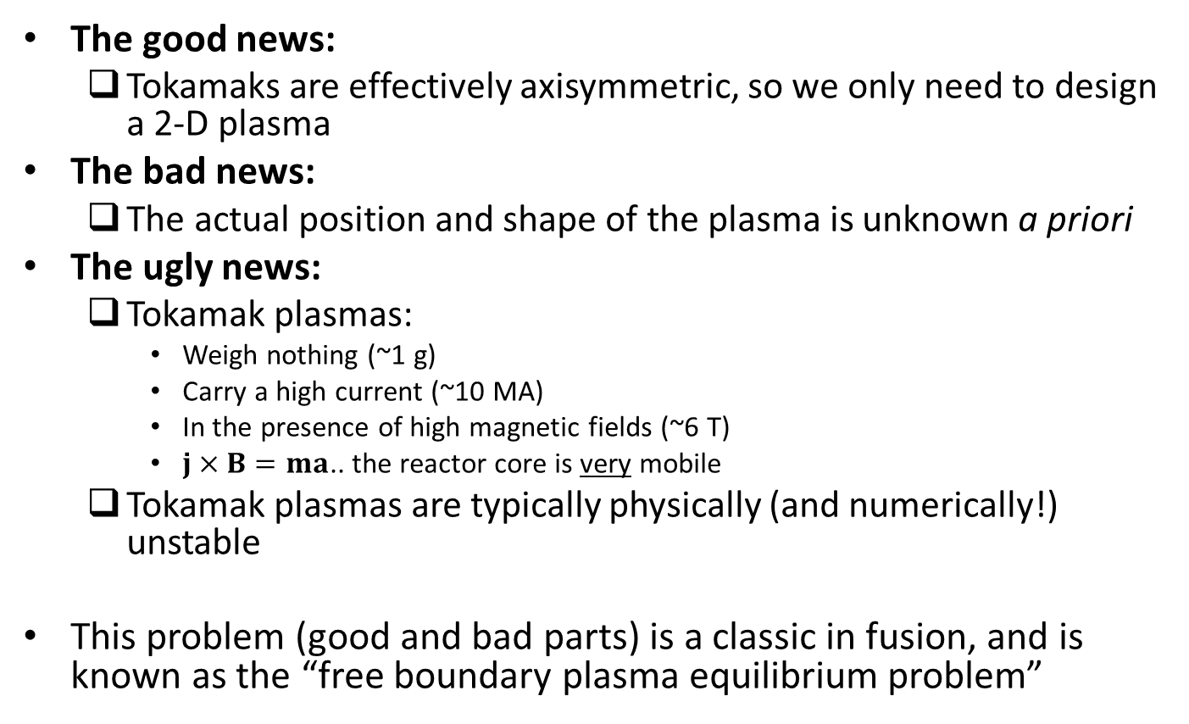
Problem definition - ii
The good news:
Tokamaks are effectively axisymmetric, so we only need to design a 2-D plasma
The bad news:
The actual position and shape of the plasma is unknown a priori
The ugly news:
Tokamak plasmas:
Weigh nothing (~1 g)
Carry a high current (~10 MA)
In the presence of high magnetic fields (~6 T)
$j×B=ma$.. the reactor core is very mobile
Tokamak plasmas are typically physically (and numerically!) unstable
This problem (good and bad parts) is a classic in fusion, and is known as the “free boundary plasma equilibrium problem”

Slide 6
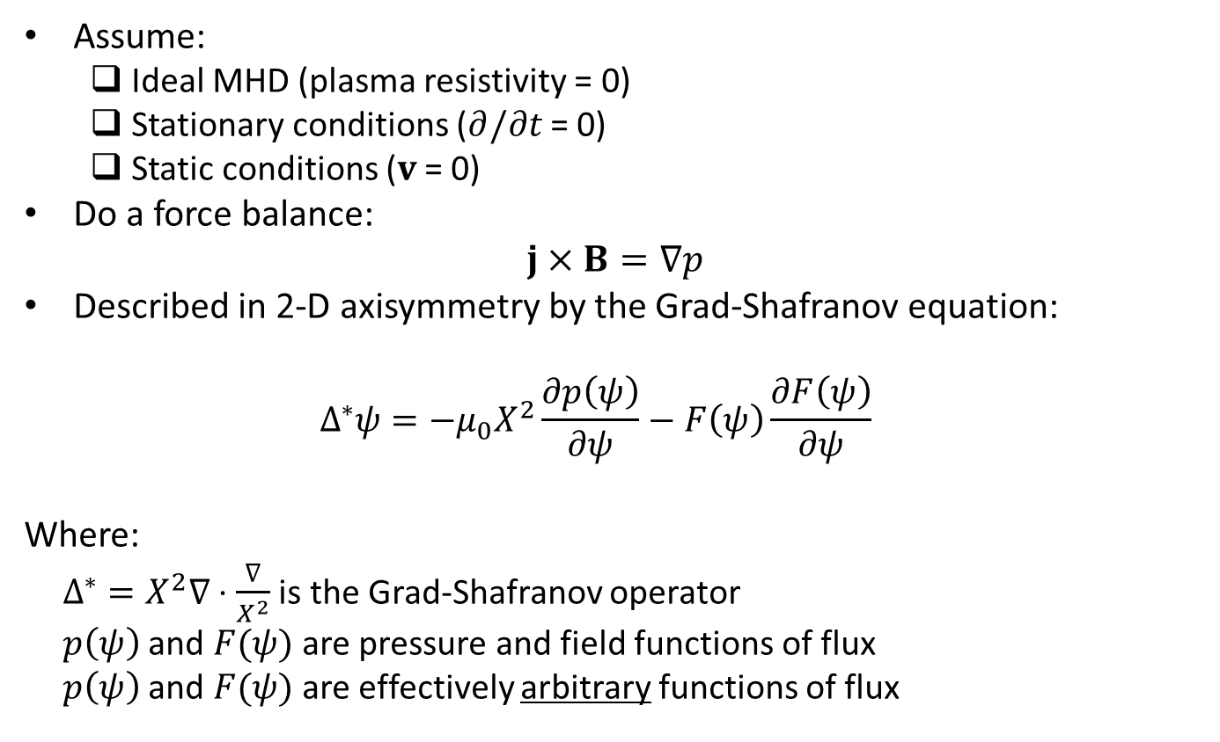
Mathematical formulation - i
Assume:
Ideal MHD (plasma resistivity = 0)
Stationary conditions ($∂/∂t$ = 0)
Static conditions ($v$ = 0)
Do a force balance:
$$j×B=∇p$$
Described in 2-D axisymmetry by the Grad-Shafranov equation:
$$Δ^{∗}ψ=−μ_{0}X^{2}\frac{∂p\left(ψ\right)}{∂ψ}−F\left(ψ\right)\frac{∂F\left(ψ\right)}{∂ψ}$$
Where:
$Δ^{∗}=X^{2}∇⋅\frac{∇}{X^{2}}$ is the Grad-Shafranov operator
$p\left(ψ\right)$ and $F(ψ)$ are pressure and field functions of flux
$p\left(ψ\right)$ and $F(ψ)$ are effectively arbitrary functions of flux

Slide 7
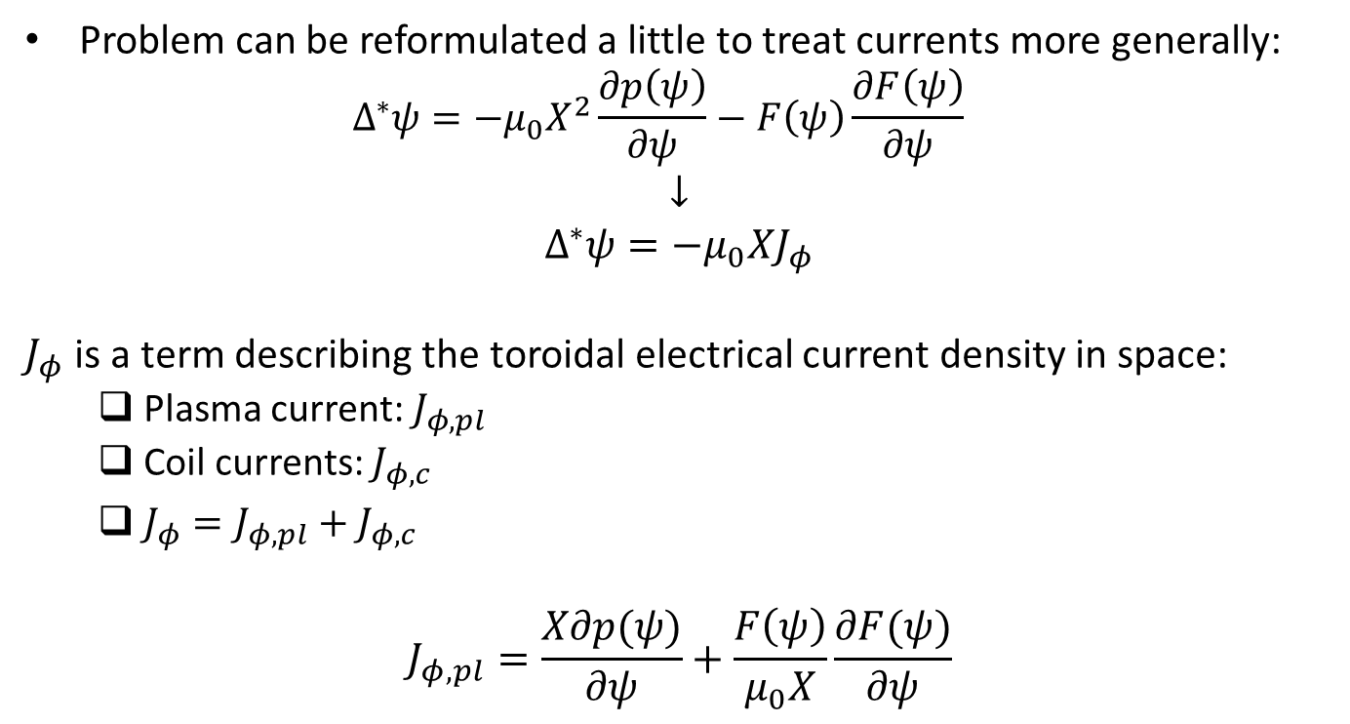
Mathematical formulation - ii
Problem can be reformulated a little to treat currents more generally:
$$Δ^{∗}ψ=−μ_{0}X^{2}\frac{∂p\left(ψ\right)}{∂ψ}−F\left(ψ\right)\frac{∂F\left(ψ\right)}{∂ψ}$$
$$↓$$
$$Δ^{∗}ψ=−μ_{0}XJ_{φ}$$
$J_{φ}$ is a term describing the toroidal electrical current density in space:
Plasma current: $J_{φ,pl}$
Coil currents: $J_{φ,c}$
$J_{φ}=J_{φ,pl}+J_{φ,c}$
$$J_{φ,pl}=\frac{X∂p(ψ)}{∂ψ}+\frac{F\left(ψ\right)}{μ_{0}X}\frac{∂F(ψ)}{∂ψ}$$

Slide 8
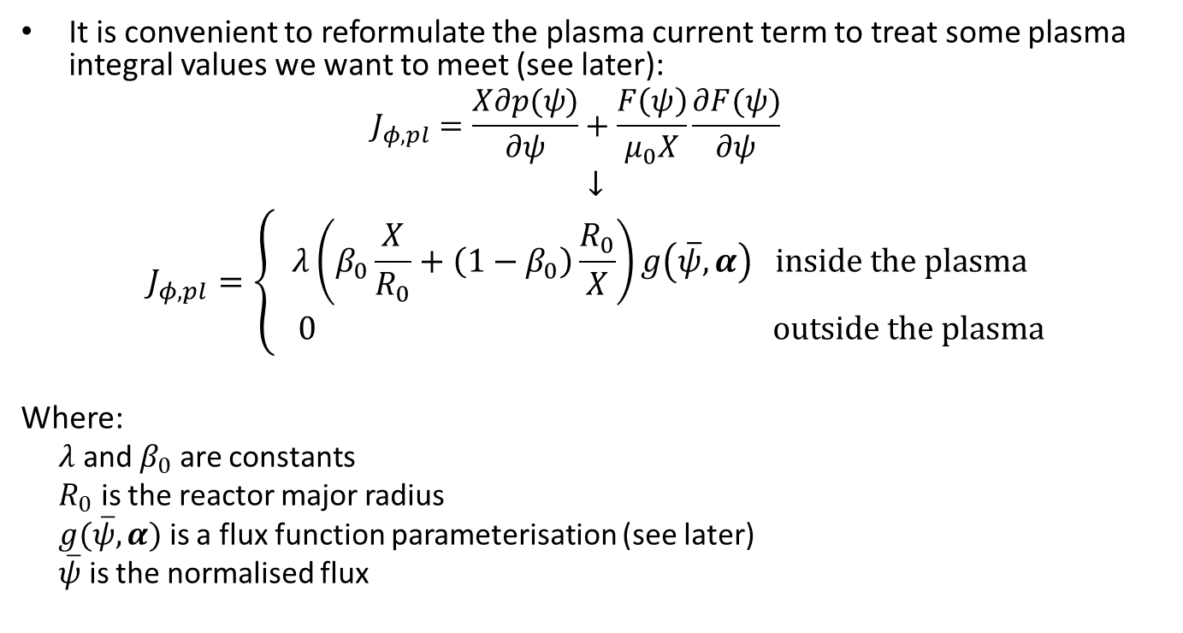
Mathematical formulation - iii
It is convenient to reformulate the plasma current term to treat some plasma integral values we want to meet (see later):
$$J_{φ,pl}=\frac{X∂p(ψ)}{∂ψ}+\frac{F\left(ψ\right)}{μ_{0}X}\frac{∂F(ψ)}{∂ψ}$$
$$↓$$
$$J_{φ,pl}=\left\{\begin{matrix}λ\left(β_{0}\frac{X}{R_{0}}+\left(1−β_{0}\right)\frac{R_{0}}{X}\right)g\left(\overline{ψ},α\right) inside the plasma \\ 0 outside the plasma\end{matrix}\right.$$
Where:
$λ$ and $β_{0}$ are constants
$R_{0}$ is the reactor major radius
$g(\overline{ψ},α)$ is a flux function parameterisation (see later)
$\overline{ψ}$ is the normalised flux

Slide 9
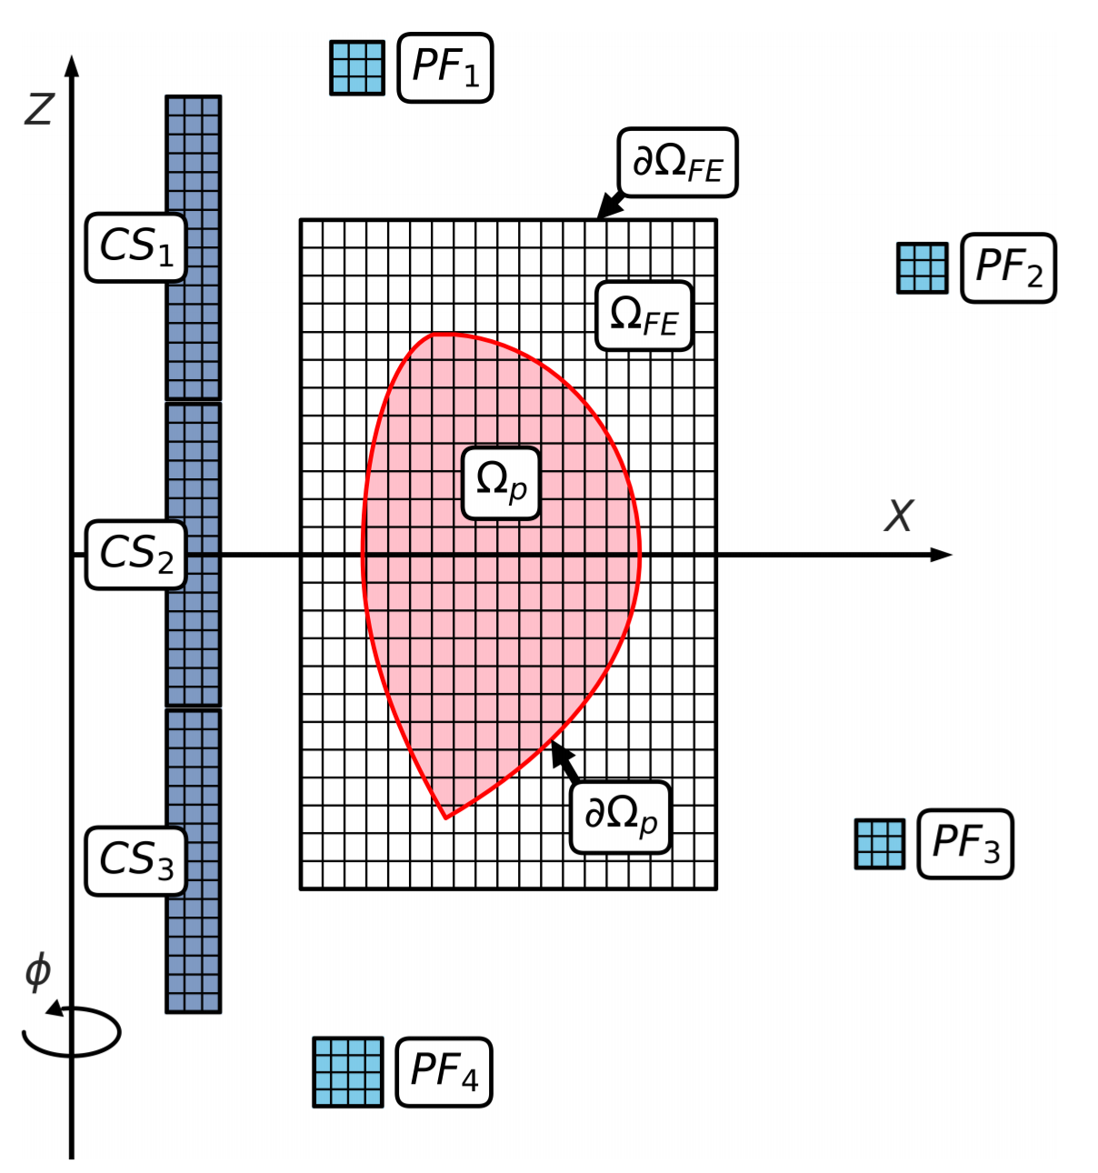
Grad-Shafranov solution strategy
Picard iterations to treat the non-linearity
Green’s functions to treat the coil currents
Finite differences to treat the plasma current
Recalculate/apply boundary condition at each step to make the boundary “free”
Find the plasma boundary at each step

Slide 10
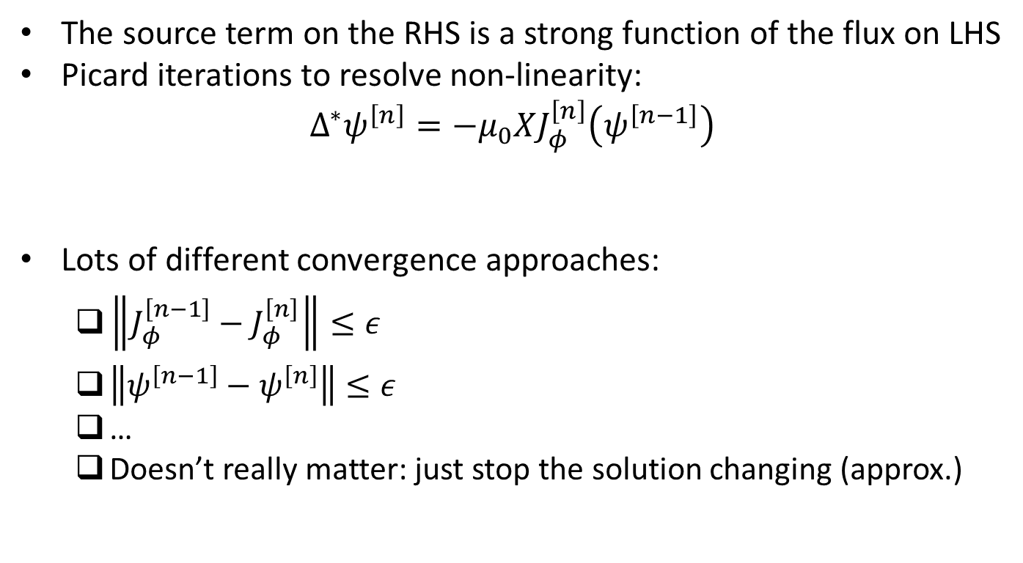
Picard iterations
The source term on the RHS is a strong function of the flux on LHS
Picard iterations to resolve non-linearity:
$$Δ^{∗}ψ^{\left[n\right]}=−μ_{0}XJ_{φ}^{\left[n\right]}\left(ψ^{\left[n−1\right]}\right)$$
Lots of different convergence approaches:
$\left\|J_{φ}^{\left[n−1\right]}−J_{φ}^{\left[n\right]}\right\|≤ε$
$\left\|ψ^{\left[n−1\right]}−ψ^{\left[n\right]}\right\|≤ε$
…
Doesn’t really matter: just stop the solution changing (approx.)

Slide 11
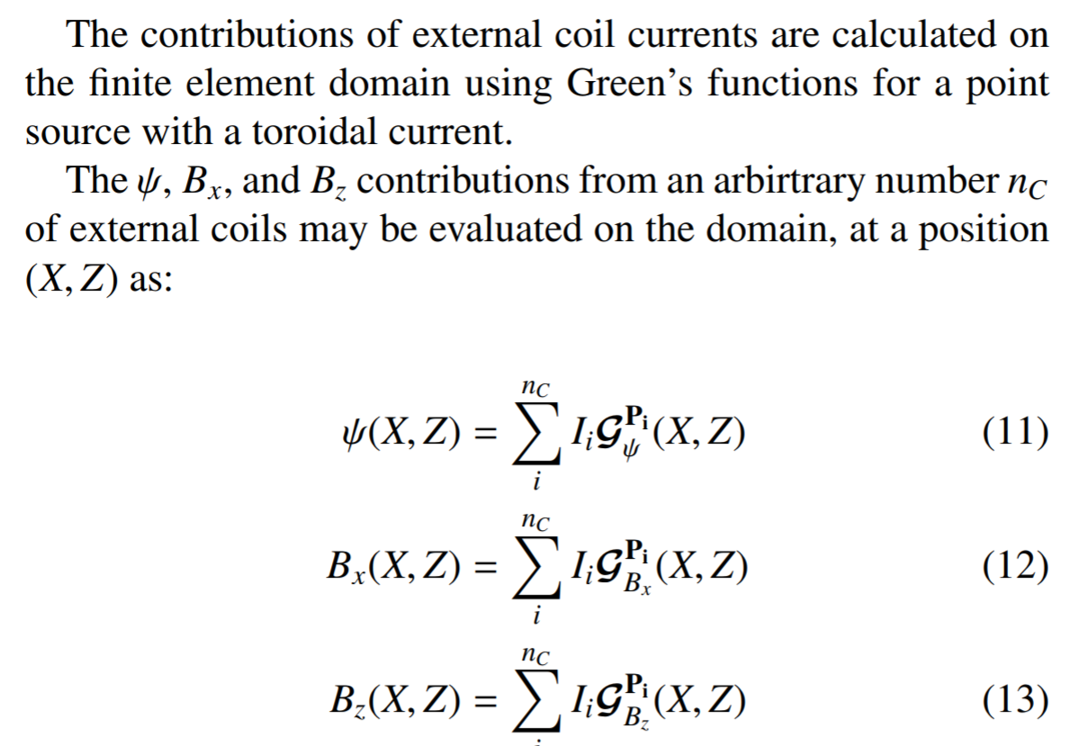
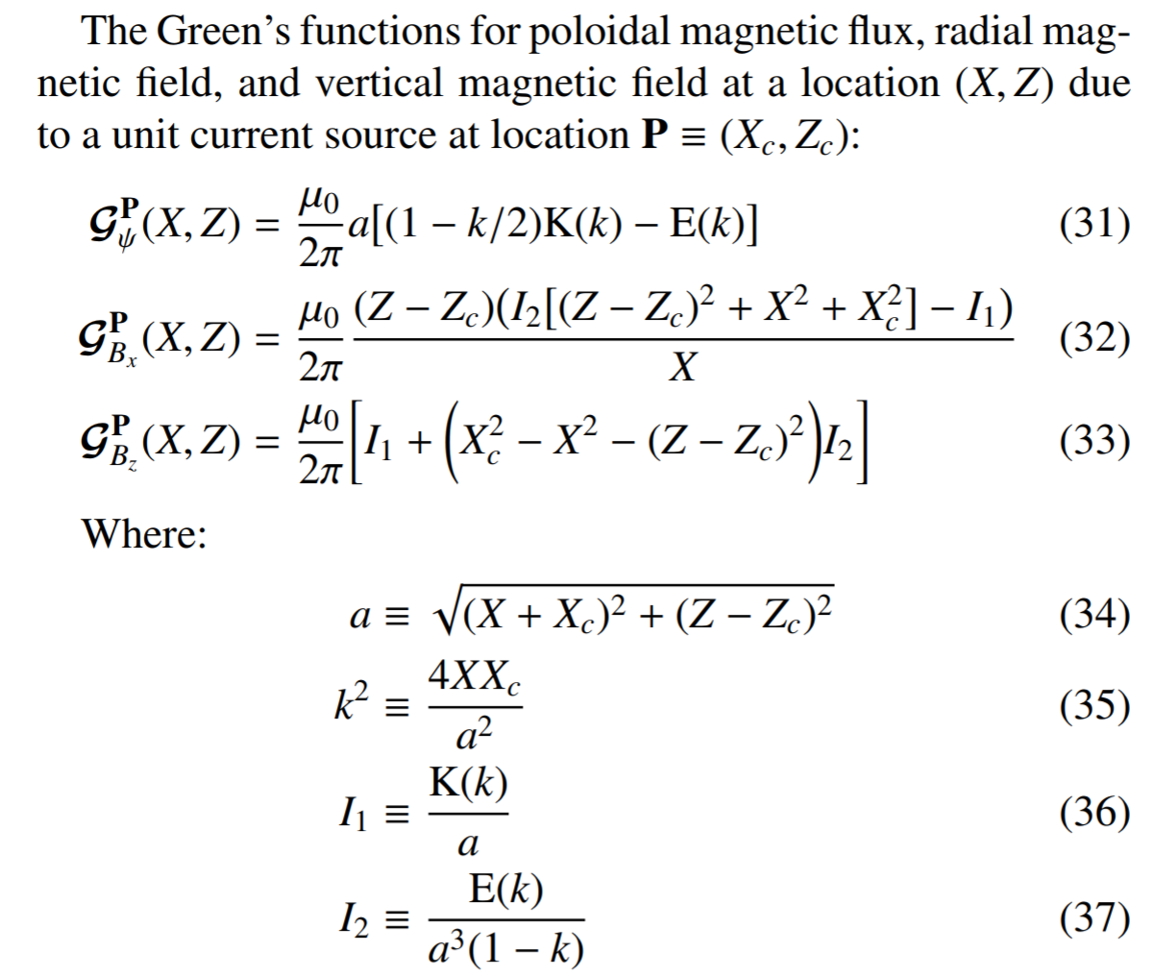
Green’s functions (Biot-Savart in 2-D, on the cheap)

Slide 12
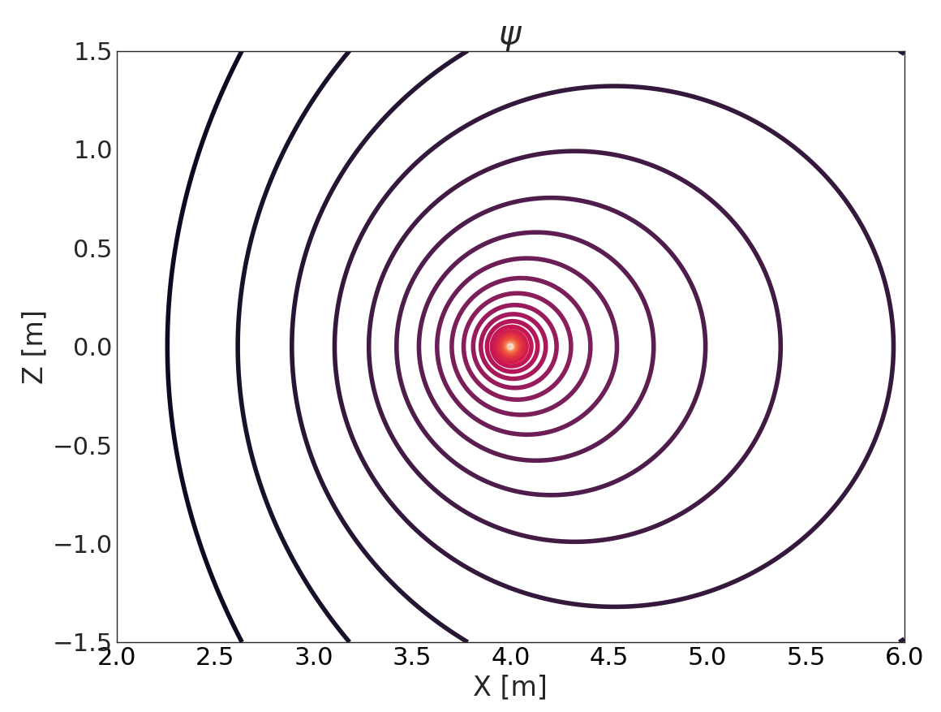
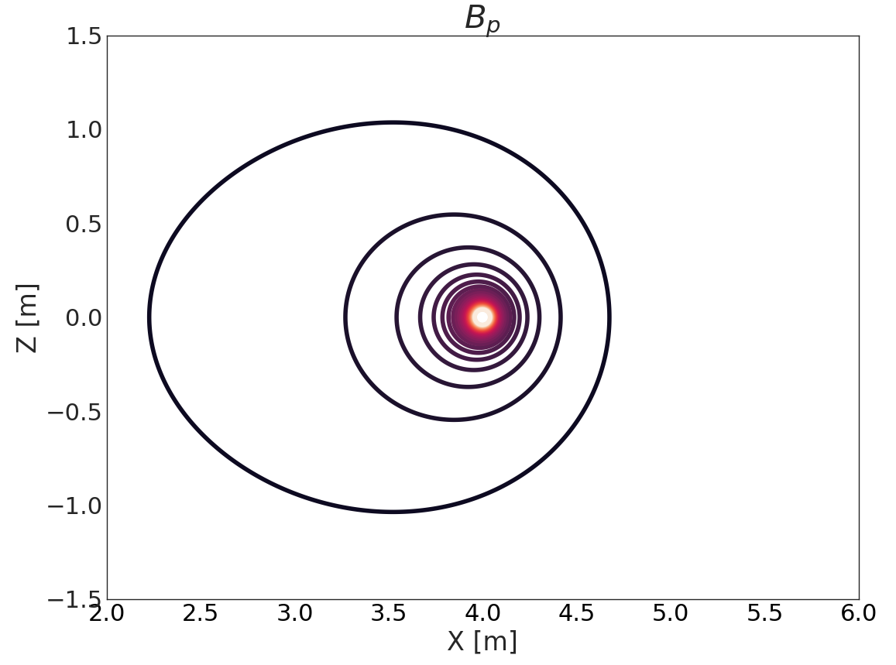
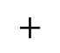
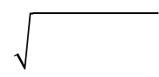
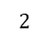
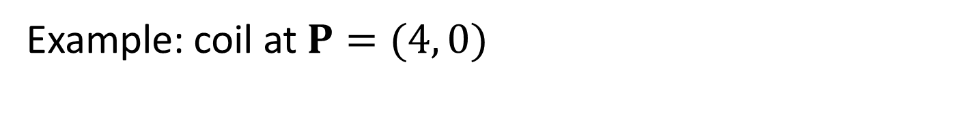
Green’s functions (Biot-Savart in 2-D, on the cheap)
Example: coil at $P=(4, 0)$
$$2$$
$$2$$
$$+$$

Slide 13
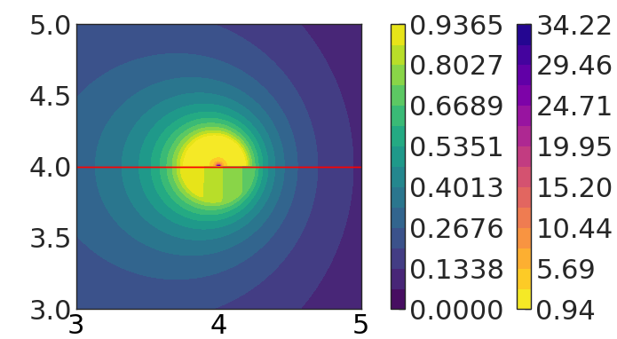
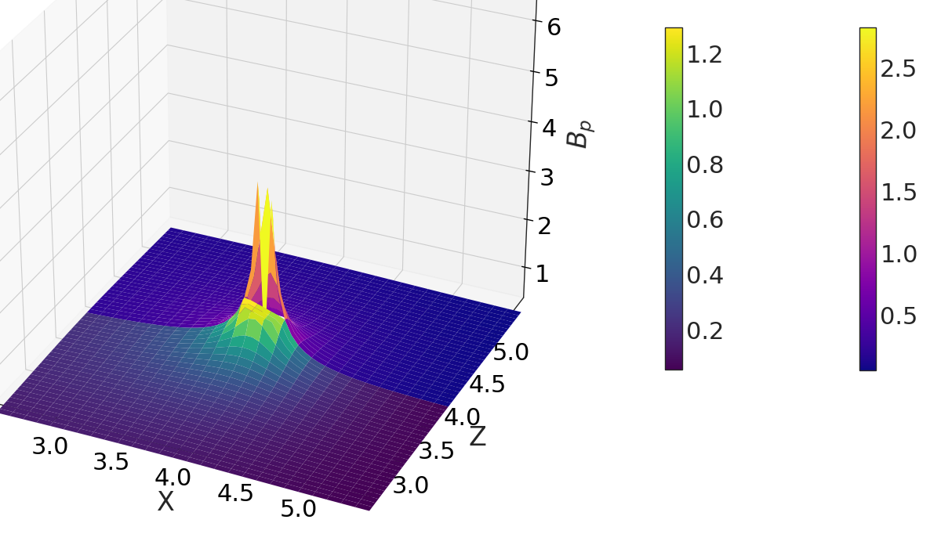
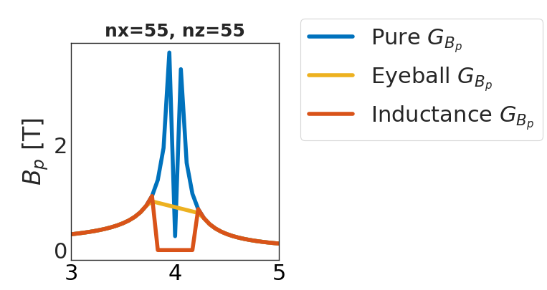
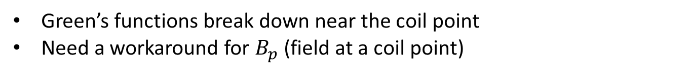
(One of the devils in the details)
Green’s functions break down near the coil point
Need a workaround for $B_{p}$ (field at a coil point)

Slide 14
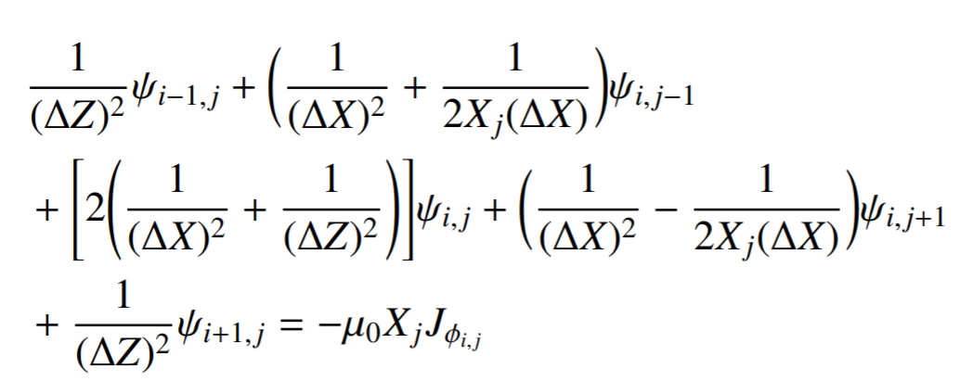
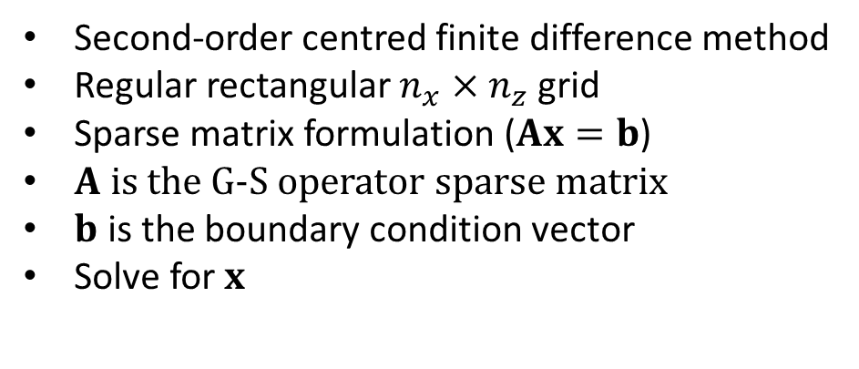
Finite difference to treat the plasma current
Second-order centred finite difference method
Regular rectangular $n_{x}×n_{z}$ grid
Sparse matrix formulation ($Ax=b$)
$A$ is the G-S operator sparse matrix
$b$ is the boundary condition vector
Solve for $x$

Slide 15
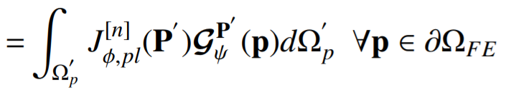
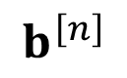
Free boundary condition
A Dirichlet boundary condition on the FE domain is implemented at each iteration step
Takes into account the position of the plasma in the previous iteration
$$b^{\left[n\right]}$$

Slide 16
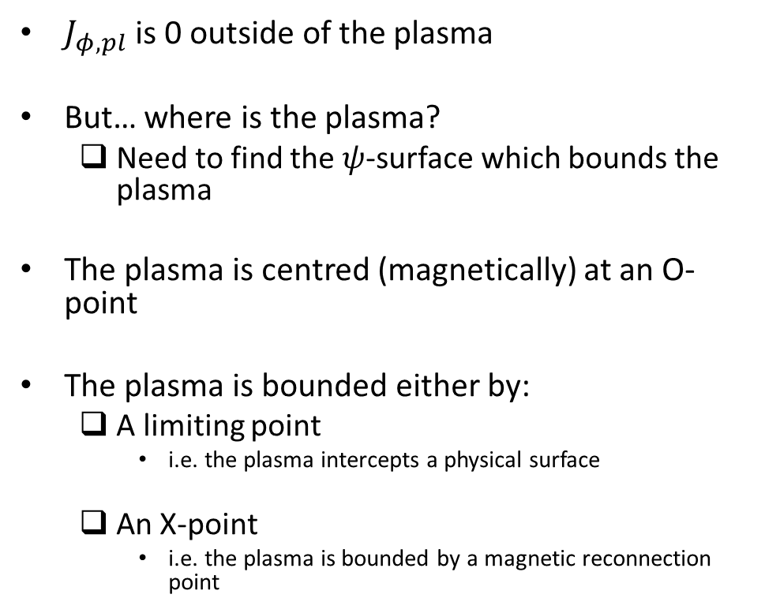
Finding the plasma boundary - i
$J_{φ,pl}$ is 0 outside of the plasma
But… where is the plasma?
Need to find the $ψ$-surface which bounds the plasma
The plasma is centred (magnetically) at an O-point
The plasma is bounded either by:
A limiting point
i.e. the plasma intercepts a physical surface
An X-point
i.e. the plasma is bounded by a magnetic reconnection point
O-point
L-point
X-point

Slide 17
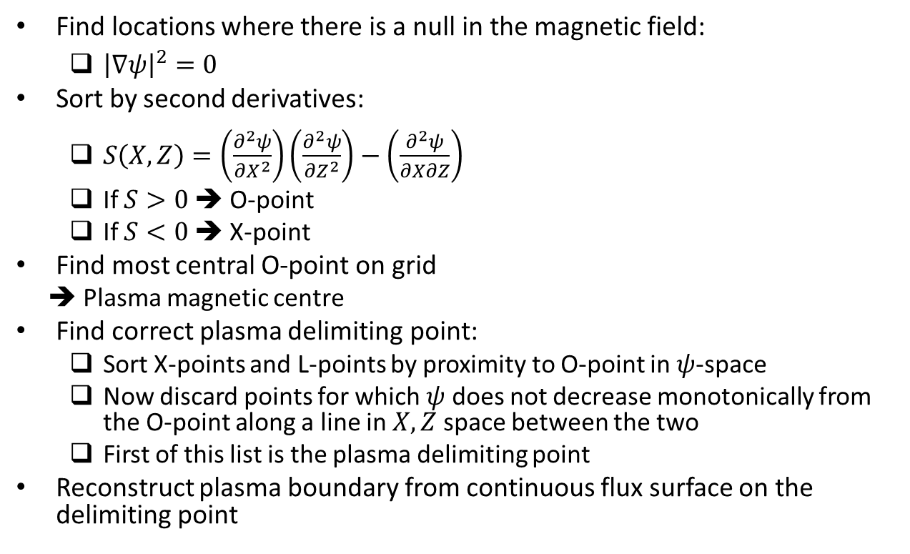
Finding the plasma boundary - ii
Find locations where there is a null in the magnetic field:
${\left|∇ψ\right|}^{2}=0$
Sort by second derivatives:
$S\left(X, Z\right)=\left(\frac{∂^{2}ψ}{∂X^{2}}\right)\left(\frac{∂^{2}ψ}{∂Z^{2}}\right)−\left(\frac{∂^{2}ψ}{∂X∂Z}\right)$
If $S>0$ ➔ O-point
If $S<0$➔ X-point
Find most central O-point on grid
➔ Plasma magnetic centre
Find correct plasma delimiting point:
Sort X-points and L-points by proximity to O-point in $ψ$-space
Now discard points for which $ψ$ does not decrease monotonically from the O-point along a line in $X, Z$ space between the two
First of this list is the plasma delimiting point
Reconstruct plasma boundary from continuous flux surface on the delimiting point
O-point
X-point

Slide 18
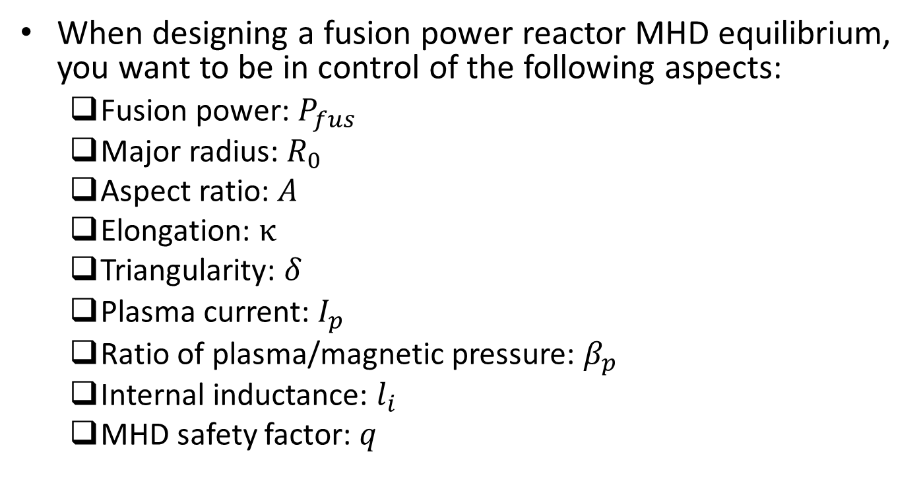
The “real world” problem (for physicists)
When designing a fusion power reactor MHD equilibrium, you want to be in control of the following aspects:
Fusion power: $P_{fus}$
Major radius: $R_{0}$
Aspect ratio: $A$
Elongation: $κ$
Triangularity: $δ$
Plasma current: $I_{p}$
Ratio of plasma/magnetic pressure: $β_{p}$
Internal inductance: $l_{i}$
MHD safety factor: $q$
Plasma shape
Plasma EM integral values

Slide 19
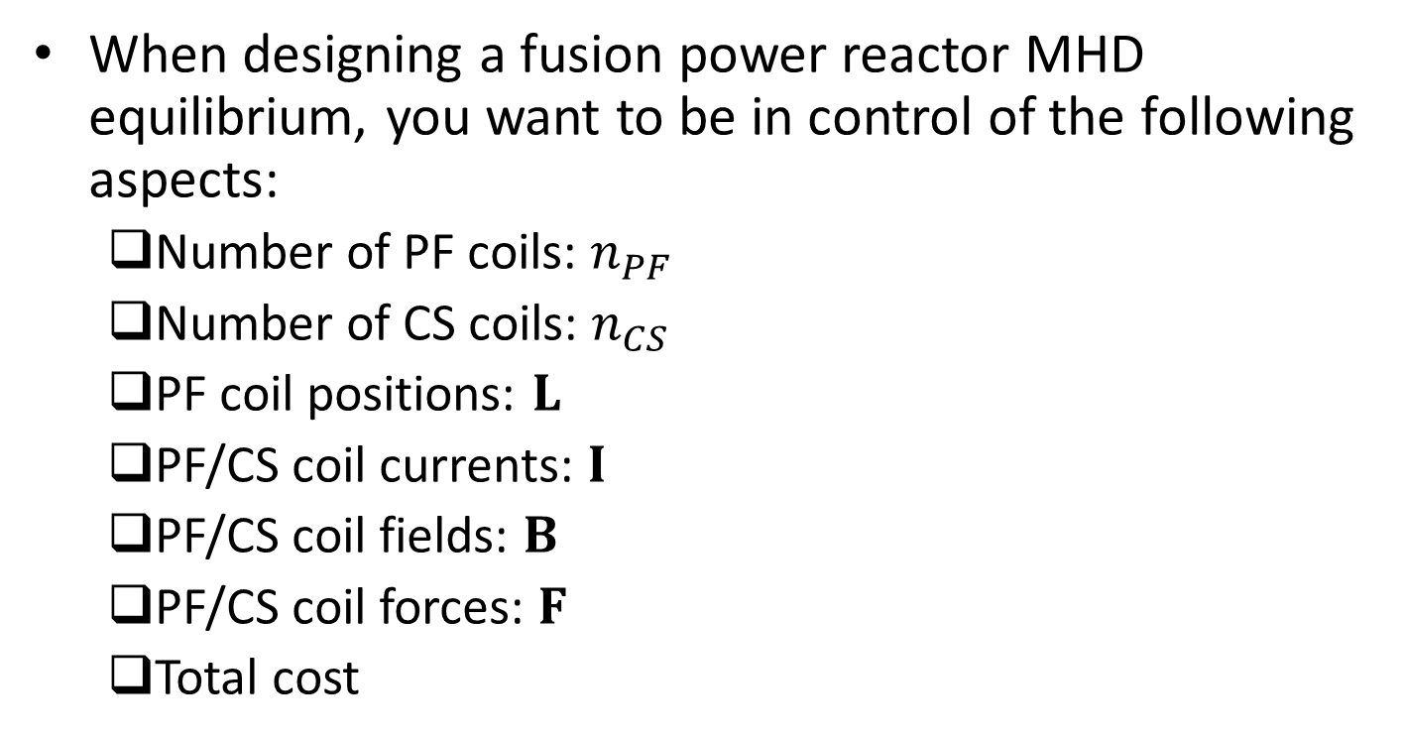
The “real world” problem (for engineers)
When designing a fusion power reactor MHD equilibrium, you want to be in control of the following aspects:
Number of PF coils: $n_{PF}$
Number of CS coils: $n_{CS}$
PF coil positions: $L$
PF/CS coil currents: $I$
PF/CS coil fields: $B$
PF/CS coil forces: $F$
Total cost
Design decisions
Design constraints
Design objective

Slide 20
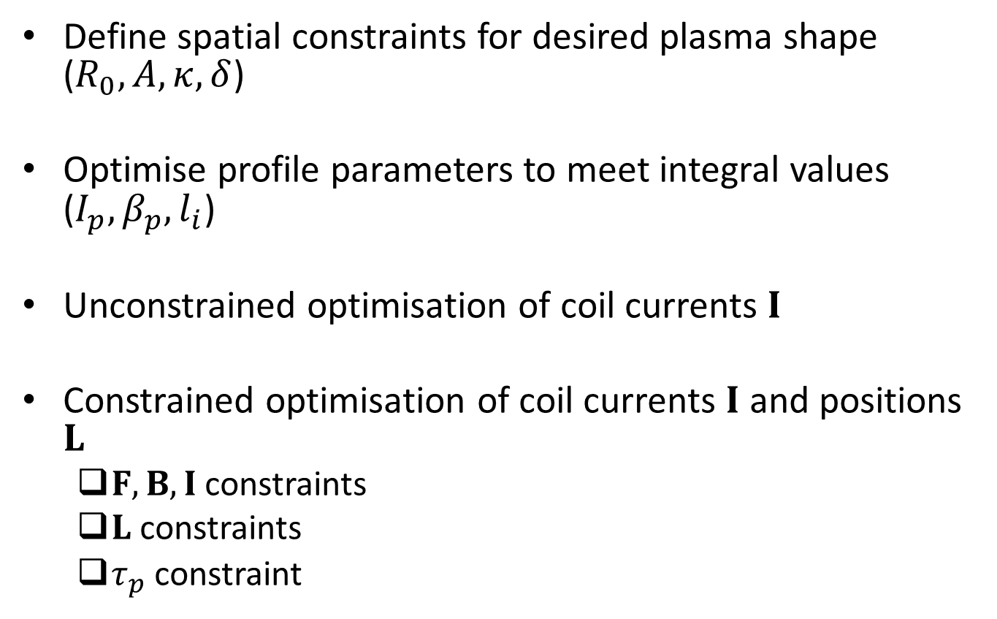
Optimisation approach
Define spatial constraints for desired plasma shape ($R_{0}, A, κ, δ$)
Optimise profile parameters to meet integral values ($I_{p}, β_{p}, l_{i}$)
Unconstrained optimisation of coil currents $I$
Constrained optimisation of coil currents $I$ and positions $L$
$F, B, I$ constraints
$L$ constraints
$τ_{p}$ constraint

Slide 21
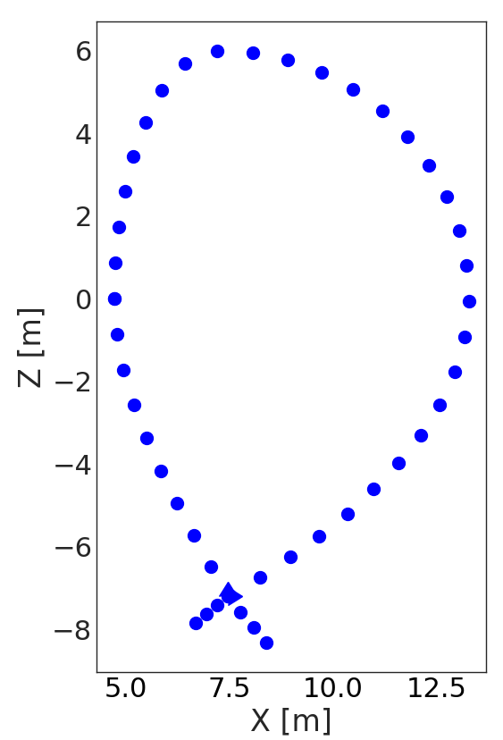
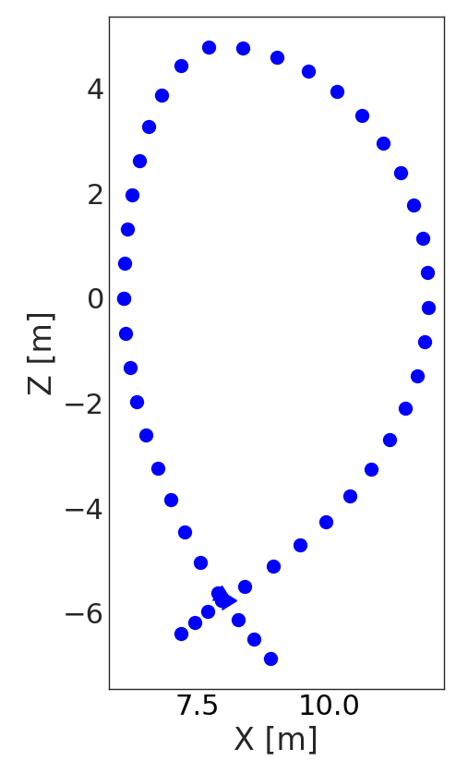
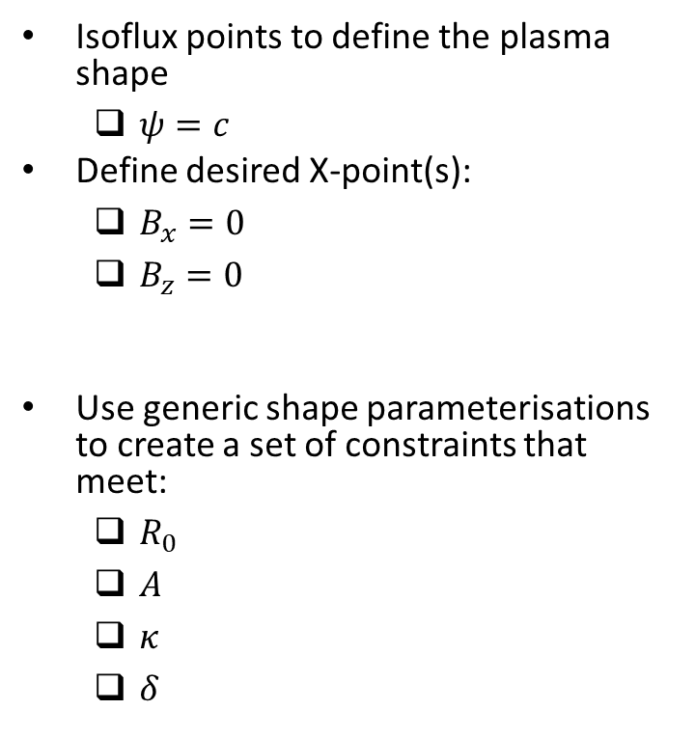
Plasma shape constraints
Isoflux points to define the plasma shape
$ψ=c$
Define desired X-point(s):
$B_{x}=0$
$B_{z}=0$
Use generic shape parameterisations to create a set of constraints that meet:
$R_{0}$
$A$
$κ$
$δ$

Slide 22
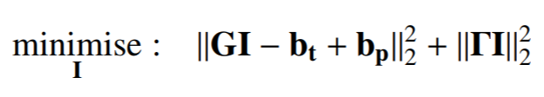
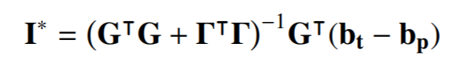
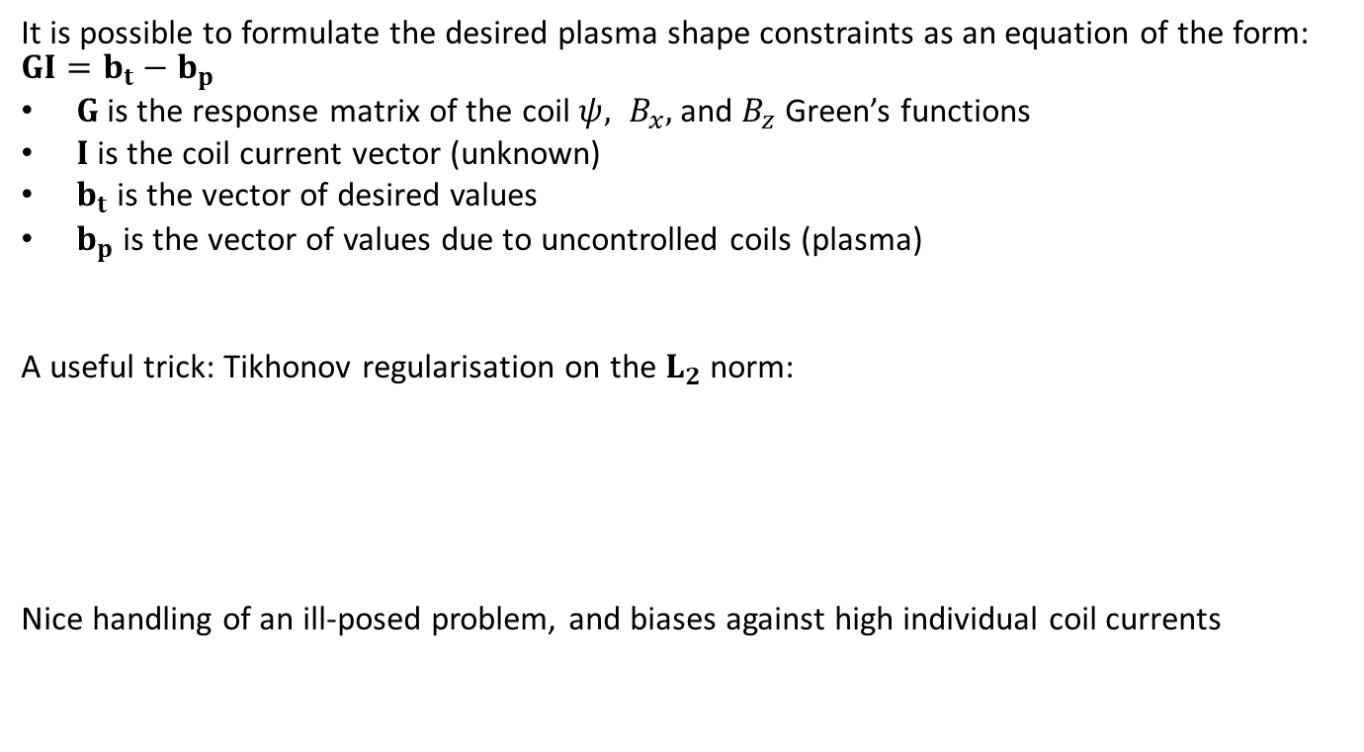
Unconstrained coil current optimisation
It is possible to formulate the desired plasma shape constraints as an equation of the form: $GI={b_{t}−b}_{p}$
$G$ is the response matrix of the coil $ψ, B_{x},$ and $B_{z}$ Green’s functions
$I$ is the coil current vector (unknown)
$b_{t}$ is the vector of desired values
$b_{p}$ is the vector of values due to uncontrolled coils (plasma)
A useful trick: Tikhonov regularisation on the $L_{2}$ norm:
Nice handling of an ill-posed problem, and biases against high individual coil currents

Slide 23
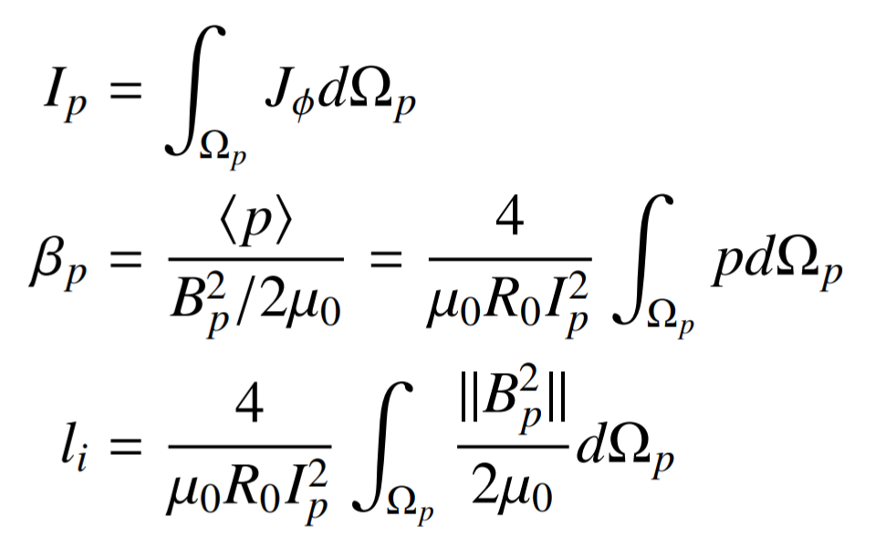
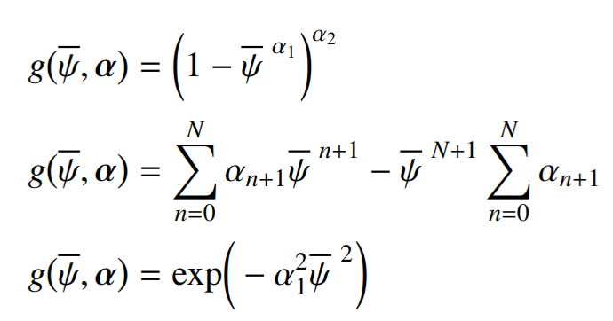
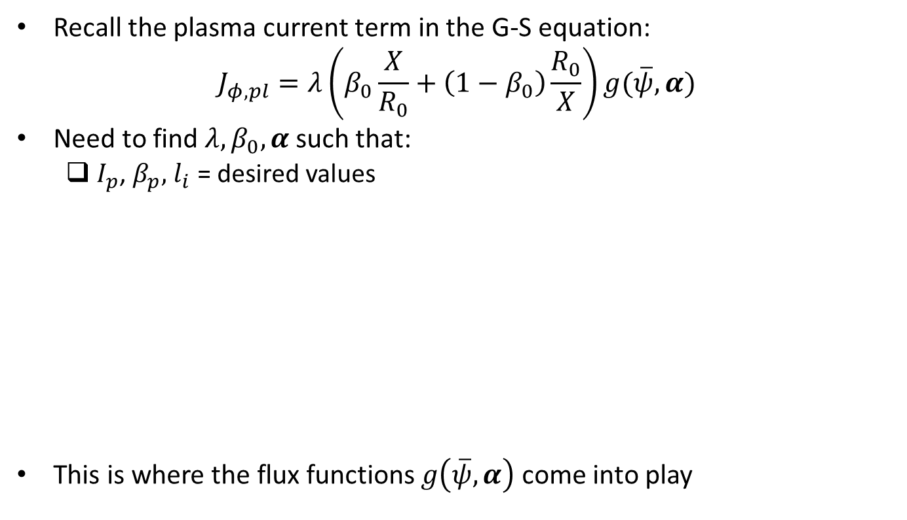
Determination of a valid plasma profile - i
Recall the plasma current term in the G-S equation:
$$J_{φ,pl}=λ\left(β_{0}\frac{X}{R_{0}}+\left(1−β_{0}\right)\frac{R_{0}}{X}\right)g(\overline{ψ},α)$$
Need to find $λ, β_{0}, α$ such that:
$I_{p}$, $β_{p},$ $l_{i}$ = desired values
This is where the flux functions $g\left(\overline{ψ}, α\right)$ come into play
Lots of flux functions.. Choose one to suit your operating regime.

Slide 24
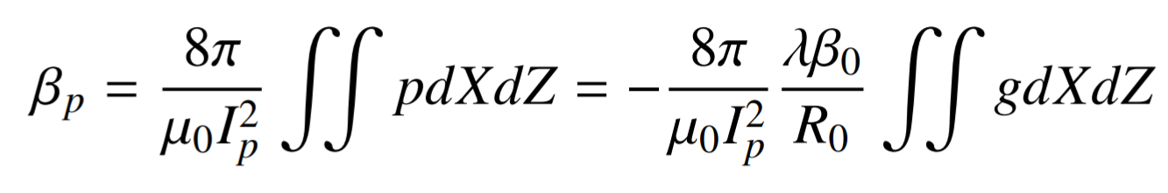
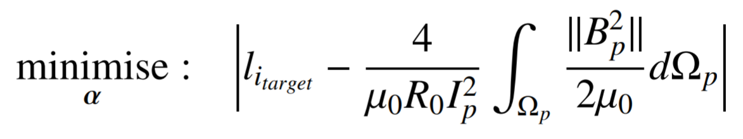
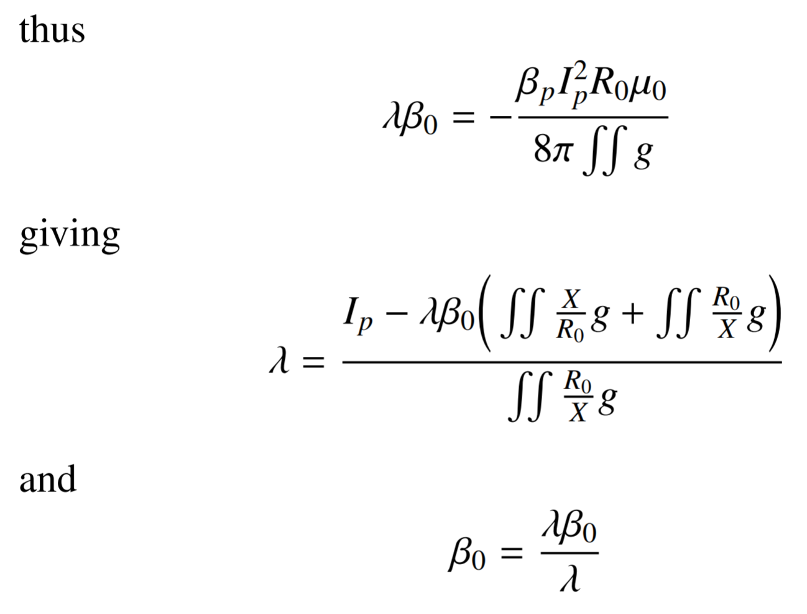
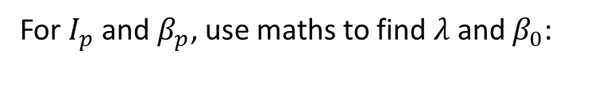
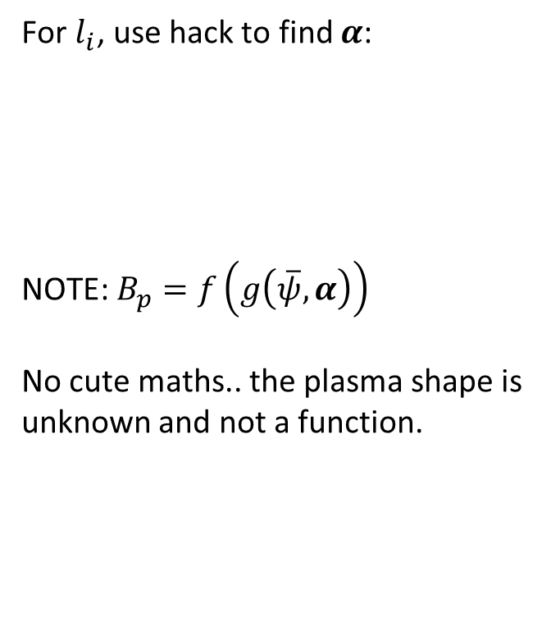
Determination of a valid plasma profile - ii
For $I_{p}$ and $β_{p}$, use maths to find $λ$ and $β_{0}$:
For $l_{i}$, use hack to find $α$:
NOTE: $B_{p}=f\left(g\left(\overline{ψ},α\right)\right)$
No cute maths.. the plasma shape is unknown and not a function.

Slide 25
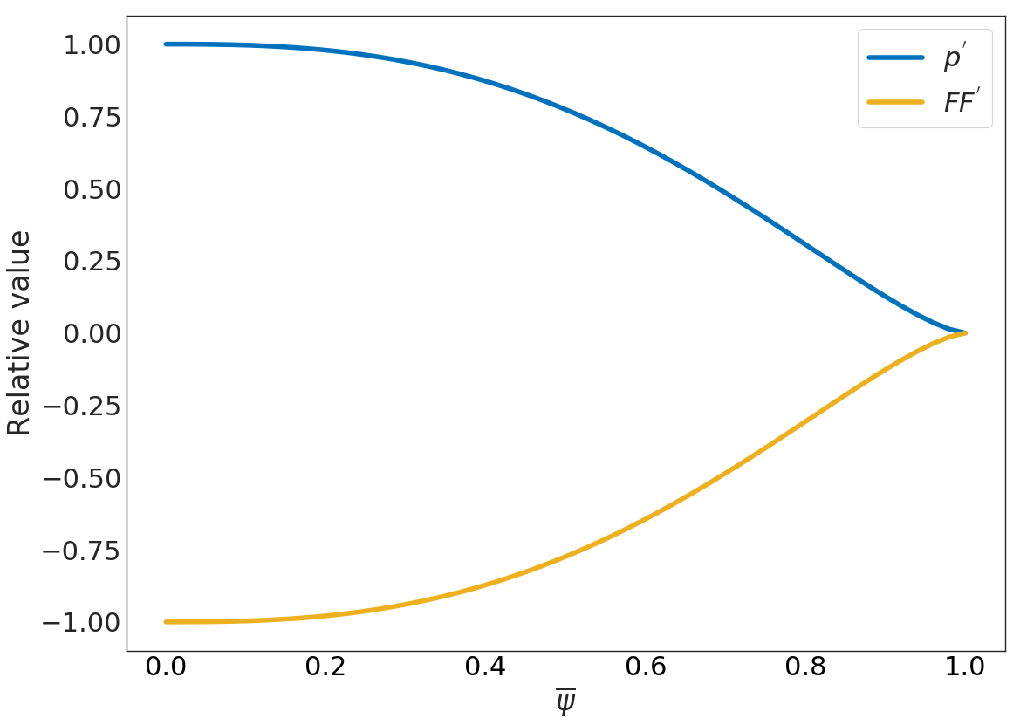
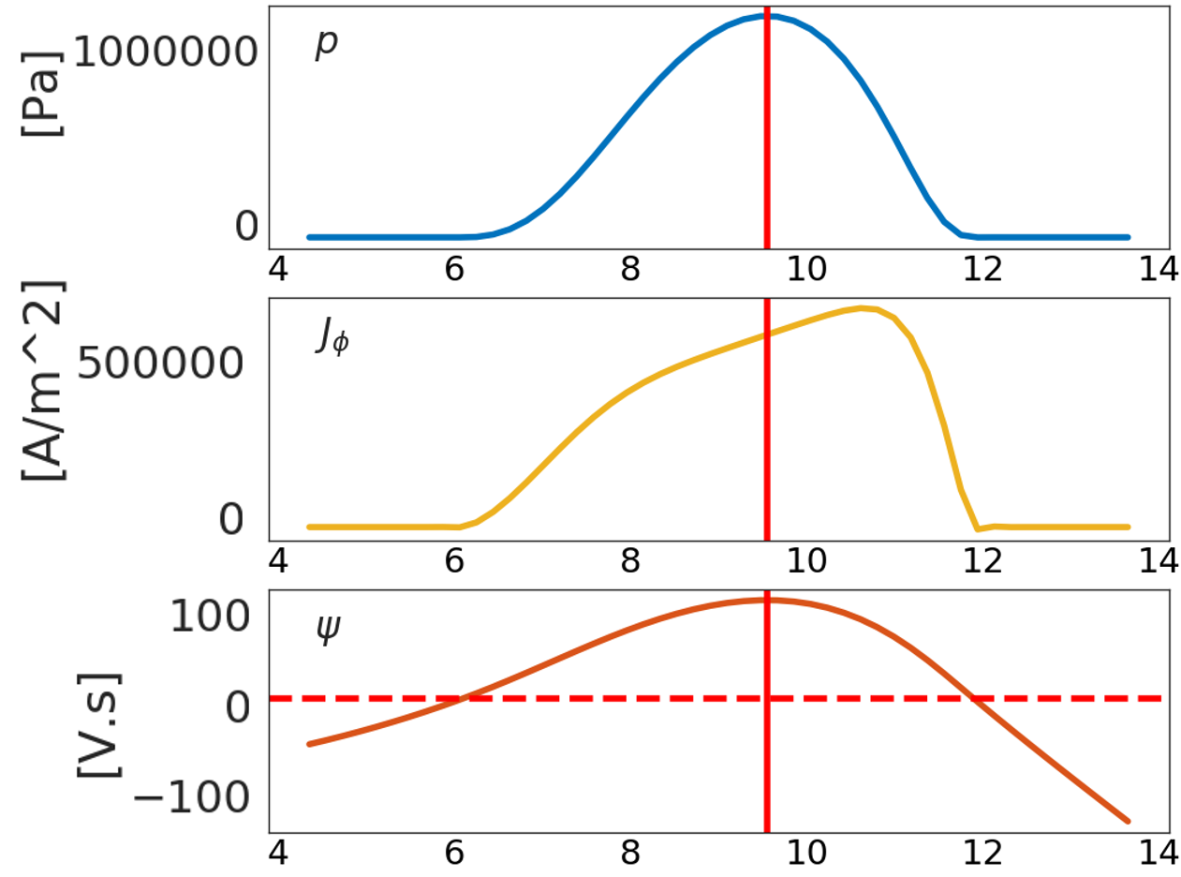

Typical $g\left(\overline{ψ}, α\right)$ and plasma profiles

Slide 26
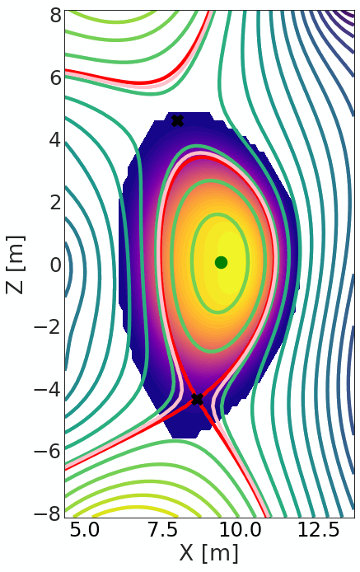
Unconstrained optimisation of plasma shape and EM integrals

Slide 27
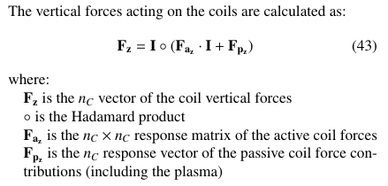
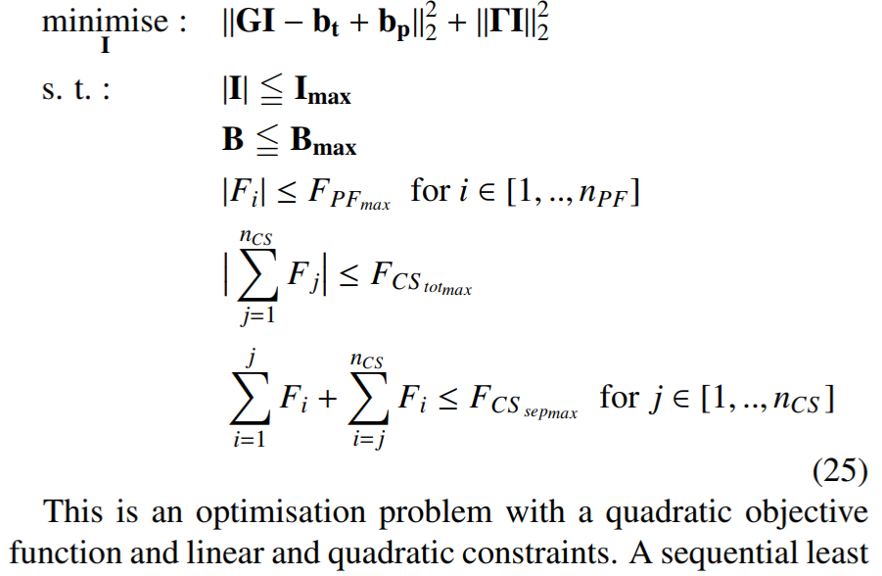
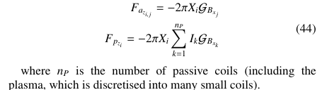
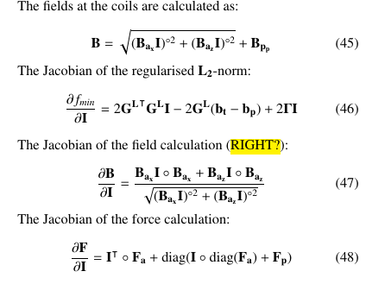
Constrained optimisation of coil currents
Now, add in engineering constraints:
Solve using a constrained sequential least squares optimiser (SLSQP)
Jacobians of objectives and constraints greatly improve speed

Slide 28
Plasma breakdown
Need to “strike” the plasma:
Region of low poloidal magnetic field (electrical field) in the centre of the machine
Rapidly swing current in central solenoid (generate large electrical field) ➔ ionisation ➔ plasma current
low T plasma becomes resistive ➔ Ohmic heating from plasma current
Turn on heating, etc.

Slide 29




Plasma breakdown
$B_{p}$ [T]
$ψ_{bd}$ = 322.3 V.s
Dashed lines:
'r': 3 mT
'g': 6 mT
'b': 9 mT

Slide 30





Pulse length constraint, $τ_{p}$
In a pulsed tokamak, we rely on the central solenoid to provide additional current drive to the plasma
Need to keep $\frac{dψ}{dt}$ going for as long as possible
For a given pulse length constraint, need to solve for equilibria with different plasma boundary flux values, $ψ_{b}$:
Start of flat-top
…
End of flat-top
$C_{Ejima}=0.4$ (literature)
$V_{burn}$ burn voltage [V]
$R_{p}$ plasma resistance [$Ω$]
$f_{Ohmic}$ fraction of Ohmic current drive

Slide 31


Constrained optimisation of coil positions
Now, optimise coil positions

Slide 32


Nested optimisation loops
G-S Picard iteration
Optimise coil positions
Optimise coil currents
SOF
MOF
Optimise plasma profiles
EOF
Optimise plasma profiles
Optimise plasma profiles
$$s.t.:$$
$$τ_{p}=c$$

Slide 33

Full constrained optimisation procedure (just one $ψ_{b}$ snapshot, for clarity)

Slide 34



Applications (SN, DN, NTT so far)

Slide 35
Some caveats..
The automation of equilibria and coilset design appears to be quite challenging:
Especially for pulsed equilibria!
CREATE (Albanese et al.) have been doing this since long before I was born… and it still takes them a few days to get it right!
Geof and other equilibrium aficionados have indicated that it is a bit of a “dark art”…
I can do some (familiar) equilibria from scratch in an automated way:
I have defined “families” of equilibria, with associated configurational parameters
I can’t yet claim this design problem is “fully automated”

